Slide 1

Campaign Results Analysis Overview of Advertising Campaign Performance
Presented By : Omkar Abhyankar
Date : 27 Oct 2024

Slide 2

Agenda
Introduction
Campaign Performance Overview
Individual Campaign Analysis
Key Insights
Conclusion

Slide 3

Introduction
Brief overview of the campaigns analyzed.
Importance of metrics in evaluating performance.

Slide 4
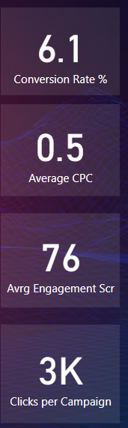
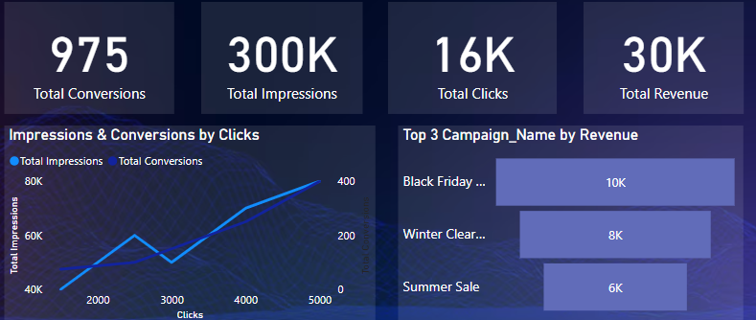
Overall Performance Metrics & Campaign Performance Summary

Slide 5
Individual Campaign Analysis
Summer Sale
Winter Clearance
Platform: Google Ads
Impressions: 50,000
Clicks: 3,000
Conversions: 150
Revenue: $6,000
ROAS: 4.00
Key Takeaways: Effective targeting of young adults.
Platform: Facebook
Impressions: 70,000
Clicks: 4,000
Conversions: 250
Revenue: $8,000
ROAS: 4.00
Key Takeaways: Strong engagement from middle-aged audience.

Slide 6
Individual Campaign Analysis
Spring Promotion
Black Friday Deals
New Year Campaign
Platform: Instagram
Impressions: 60,000
Clicks: 2,500
Conversions: 100
Revenue: $3,000
ROAS: 2.50
Key Takeaways: Needs improved targeting or creative adjustments.
Platform: Twitter
Impressions: 80,000
Clicks: 5,000
Conversions: 400
Revenue: $10,000
ROAS: 4.00
Key Takeaways: Best performer across all metrics.
Platform: LinkedIn
Impressions: 40,000
Clicks: 1,500
Conversions: 75
Revenue: $2,500
ROAS: 2.50
Key Takeaways: Lowest ROAS, needs strategy reassessment.

Slide 7


